Slide 1
Optimizing Safety Driven Navigation Aid for the Visually Impaired
Batch No: 03
Team Members:
Agalya.K (211521205008)
Sai Sruthi .AS (211521205014)
Anbarasi.K (211521205015)
Guided By:
MRS.V.RAJESWARI,ME.,
ASSISTANT PROFESSOR
Department Of Information & Technology
Panimalar Institute Of Technology

Slide 2
Abstract
In recent times, urban navigation has become more challenging for visually impaired individuals who lack awareness of obstacles around them, making independent movement difficult. To address this, we propose a smart obstacle detection and navigation system designed to enhance mobility and safety.
This system employs sensors strategically placed to cover four directions, allowing real-time identification of obstacles within the user's vicinity. When an obstacle is detected, an alert is triggered through a buzzer, and the system provides audio guidance to navigate towards a safer, obstacle-free path.
By using advanced audio instructions, users can move confidently in unfamiliar environments. The device's compact and wearable design makes it convenient for daily use, encouraging visually impaired individuals to explore the city independently while minimizing the risk of collisions. This solution not only increases accessibility but also fosters a sense of autonomy, enabling users to navigate public spaces safely and confidently.

Slide 3
Literary Survey
S. No | Year | Title | Author | Merits | Demerits
1. | 2021 | IoT-Based Smart Walking Stick for the Visually Impaired | A. Sharma, P. Verma, et al. | Uses ultrasonic sensors to detect obstacles and alert the user through vibrations and audio feedback. | Limited detection range and may not be effective in detecting fast-moving objects.
2. | 2022 | AI-Powered Wearable Navigation Aid for Blind People | R. Kumar, M. Singh, et al. | Integrates AI-based object recognition for real-time path guidance and enhanced obstacle detection. | High computational cost and requires a stable internet connection for cloud processing

Slide 4
Existing System
White Canes: Traditionally, visually impaired individuals use a white cane to detect obstacles, which requires physical contact and provides limited information about distant objects.
Guide Dogs:Guide dogs offer assistance by leading users around obstacles, yet they are costly, require extensive training, and may not always navigate complex urban environments effectively.
GPS-based Apps: Offer directional guidance but do not detect immediate physical obstacles.
These systems have limitations in ensuring immediate safety and lack real-time feedback on the physical surroundings, which is crucial for the visually impaired

Slide 5
Proposed System
Real-Time Obstacle Detection: The system uses sensors to detect obstacles in four directions, providing immediate alerts to the user, ensuring proactive awareness of the surroundings.
Audio Navigation Guidance: Users receive audio cues to safely navigate toward open spaces, enhancing mobility and reducing dependency on physical contact with obstacles.
Affordable and Compact Design: The lightweight, wearable device offers cost-effective, hands-free assistance, enabling visually impaired individuals to explore public spaces independently and confidently.

Slide 6
System Requirements
HARDWARE REQUIREMENT
SOFTWARE REQUIREMENT:
POWER SUPPLY
ARDUINO UNO
LCD
I2C
ULTRASONIC SENSOR
DF PLAYER
SPEAKER
BUZZER
ARDUINO IDE
EMBEDDED C

Slide 7
System Architecture
In the proposed system, the Arduino Uno serves as the core controller, coordinating sensor inputs and alert outputs.
Four ultrasonic sensors are positioned to monitor each direction around the user, continuously scanning for obstacles. When an obstacle is detected in any direction, the Arduino processes this information and determines which side is free.
It then activates an audio module, providing voice instructions through a speaker to guide the user toward the unobstructed path.
Simultaneously, a buzzer sounds to give immediate alerts, enhancing awareness of nearby obstacles and ensuring safer navigation for the visually impaired.

Slide 8
List of Modules
Object Detection Module: Detects objects within a specific range.
Alert Module: Generates sound alerts to notify users.
Power Management Module: Manages the battery or power supply.
Communication Module: Manages connections for IoT data (optional).
User Interface Module: Simple interface to control settings (volume, etc.).

Slide 9
Algorithm
Obstacle detection algorithm
Path planning algorithm
Ultrasonic sensor data processing algorithm
Decision-making algorithm
Audio guidance control algorithm
Alert mechanism algorithm

Slide 10
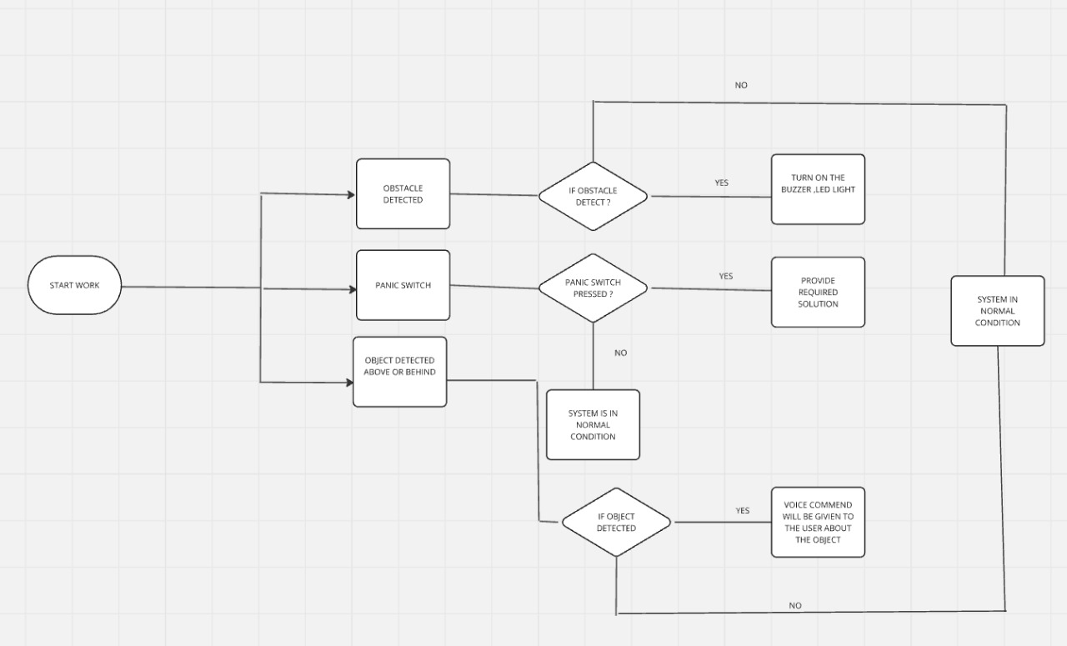
Workflow Diagram

Slide 11
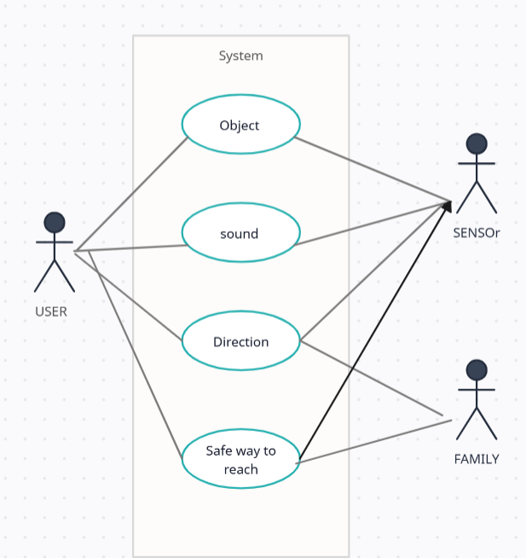
Use-case Diagram
Add Diagram

Slide 12
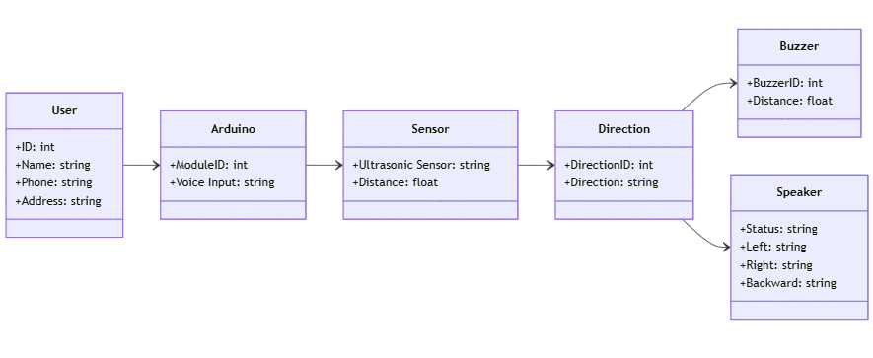
Class Diagram
Add Diagram

Slide 13
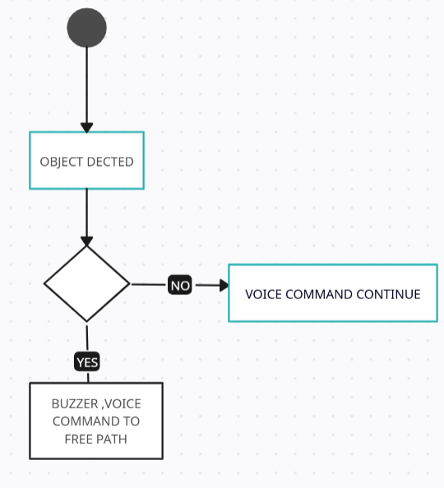
Activity Diagram
Add Diagram

Slide 14
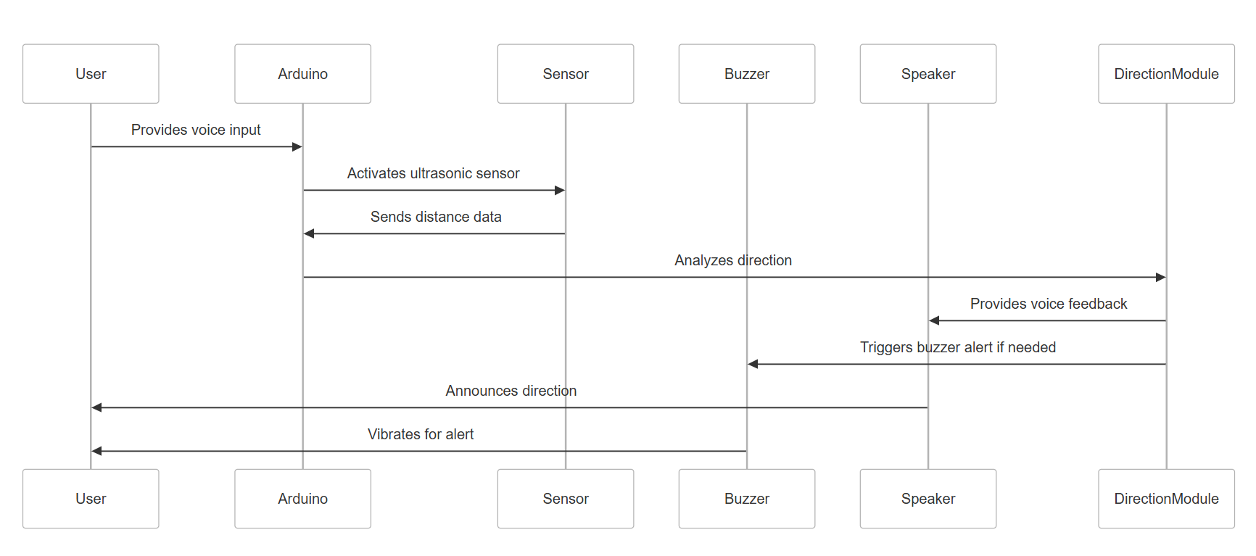
Sequence Diagram
Add Diagram

Slide 15
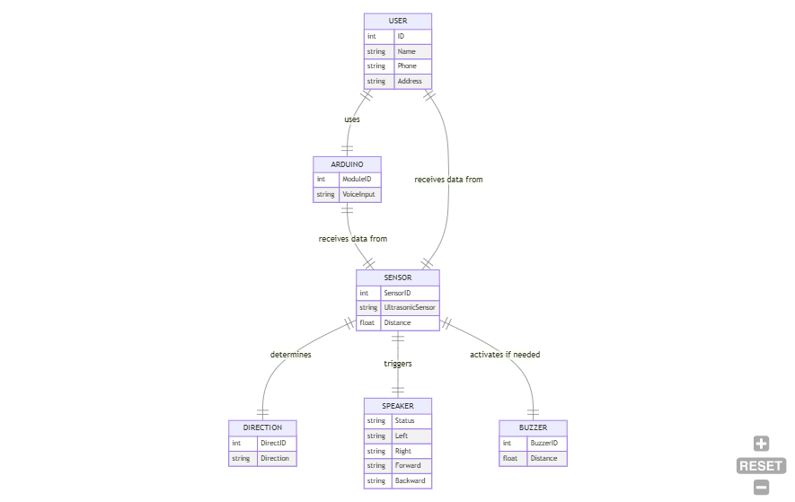
Entity Relationship Diagram

Slide 16
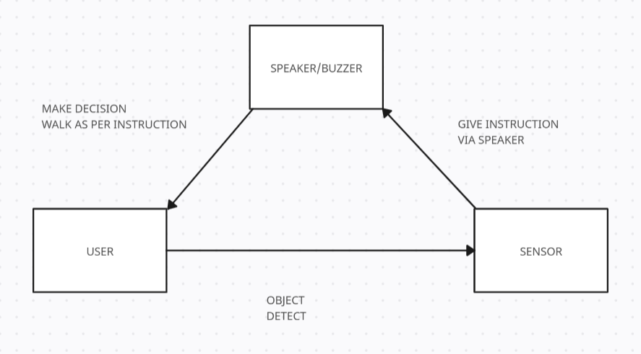
Collaboration Diagram
Add Diagram

Slide 17
Advantages
Enhanced Safety: Real-time obstacle detection alerts users immediately, reducing the risk of collisions and improving safety in crowded or unfamiliar areas.
Hands-Free Navigation: Audio guidance enables users to navigate without physical contact, allowing for a smoother and more comfortable experience.
Increased Independence: The system empowers visually impaired individuals to explore public spaces independently, fostering confidence and autonomy.
Cost-Effective Solution: Compared to guide dogs, this system offers an affordable alternative, making advanced navigation support accessible to a larger population.
Compact and Portable: The device’s lightweight design is easy to carry and wear, suitable for daily use without adding bulk.

Slide 18
Future Enhancements
AI-Powered Obstacle Avoidance – Advanced sensors and AI algorithms can detect obstacles and automatically adjust speed, direction, and path to ensure a smooth and collision-free ride.
Assistance with Robotics – Combining the visual aid with robotic guides or drones can offer enhanced mobility solutions in unfamiliar or complex environments.
Self-Balancing Mobility Aid – The device can be integrated with a hoverboard-like mechanism, allowing visually impaired individuals to move effortlessly with auto-balancing technology, reducing physical strain.

Slide 19
Conclusion
The "Optimizing Safety Driven Navigation Aid for the Visually Impaired " project presents an innovative solution to enhance mobility and independence for visually impaired individuals.
By integrating IoT-enabled sensors, real-time object detection, and auditory feedback, the system ensures a safer and more efficient navigation experience. The proposed solution not only improves accessibility but also leverages modern technologies such as AI, cloud computing, and smart city integration for future advancements.
With further developments in wearable technology, autonomous navigation, and multi-sensory feedback, this project has the potential to revolutionize assistive mobility solutions, ultimately improving the quality of life for visually impaired individuals worldwide.

Slide 20
References
Bourne, R. R., Flaxman, S. R., Braithwaite, T., Cicinelli, M. V., Das, A., Jonas, J. B., ... & Naidoo, K. (2017). Magnitude, temporal trends, and projections of the global prevalence of blindness and distance and near vision impairment: a systematic review and meta-analysis. The Lancet Global Health, 5(9), e888-e897.
[2] The Financial Express. (2020). Visual impairment to increase dramatically: Study. Retrieved from https://thefinancialexpress.com.bd/health/visual-impairment toincrease-dramatically-study-1579444915
[3] Wiener, W. R., Welsh, R. L., & Blasch, B. B. (2010). Foundations of orientation and mobility (Vol. 1). American Foundation for the Blind
[4] Wiener, W. R., Welsh, R. L., & Blasch, B. B. (2010). Foundations of orientation and mobility (Vol. 1). American Foundation for the Blind
[5] Jawale, R. V., Kadam, M. V., Gaikawad, R. S., & Kondaka, L. S. (2017, September). Ultrasonic navigation based blind aid for the visually impaired. In 2017 IEEE International Conference on Power, Control, Signals and Instrumentation Engineering (ICPCSI) (pp. 923- 928). IEEE.

Slide 21
Thank you

